Slide 1
DOMAIN MODEL VISUALIZING CONCEPTS
Biju R Mohan
Lecture 12

Slide 2
Agenda
Identify conceptual classes related to the current iteration requirements.
Create an initial domain model.
Distinguish between correct and incorrect attributes.
Add specification conceptual classes, when appropriate.
Compare and contrast conceptual and implementation views.

Slide 3
What is domain model ?
A domain model illustrates meaningful conceptual classes in a problem domain; it is the most important artifact to create during object-oriented analysis.
Identifying a rich set of objects or conceptual classes is at the heart of object-oriented analysis, and well worth the effort in terms of payoff during the design and implementation work.
The identification of conceptual classes is part of an investigation of the problem domain. The UML contains notation in the form of class diagrams to illustrate domain models.

Slide 4
Key Point
A domain model is a representation of real-world conceptual classes, not of software components. It is not a set of diagrams describing software classes, or software objects with responsibilities.

Slide 5
Domain Model
The UP defines a Domain Model as one of the artifacts that may be created in the Business Modeling discipline.
Using UML notation, a domain model is illustrated with a set of class diagrams
domain objects or conceptual classes
associations between conceptual classes
attributes of conceptual classes

Slide 6
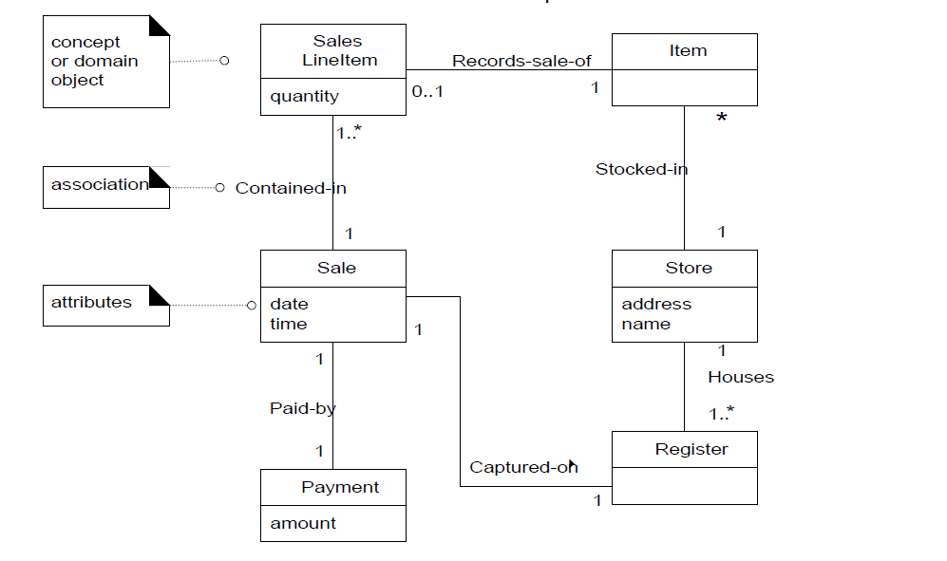
Partial Domain Model of POS problem

Slide 7
Domain Models Are not Models of Software Components
A domain model is a visualization of things in the realworld domain of interest, not of software components such as a Java or C++
Therefore, the following elements are not suitable in a domain model:
Software artifacts, such as a window or a database, unless the domain being modeled is of software concepts, such as a model of graphical user interfaces.
Responsibilities or methods.

Slide 8
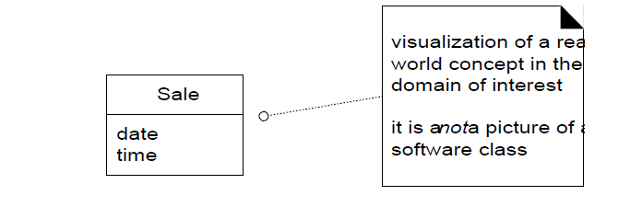
Example

Slide 9
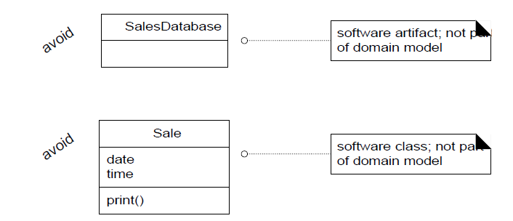
Avoid

Slide 10
Conceptual Classes
Informally, a conceptual class is an idea, thing, or object. More formally, a conceptual class may be considered in terms of its symbol, intension, and extension
Symbol—words or images representing a conceptual class.
Intension—the definition of a conceptual class.
Extension—the set of examples to which the conceptual class applies

Slide 11
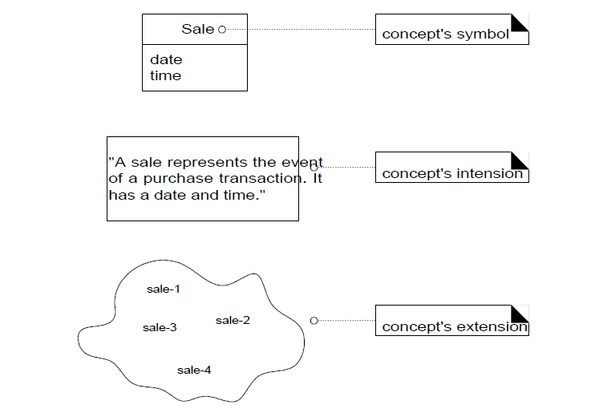

Slide 12
OOAD Vs Structured Analysis
A central distinction between object-oriented and structured analysis is: division by conceptual classes (objects) rather than division by functions

Slide 13
Conceptual Class Identification
Two techniques are presented in the following sections:
1. Use a conceptual class category list.
2. Identify noun phrases.

Slide 14
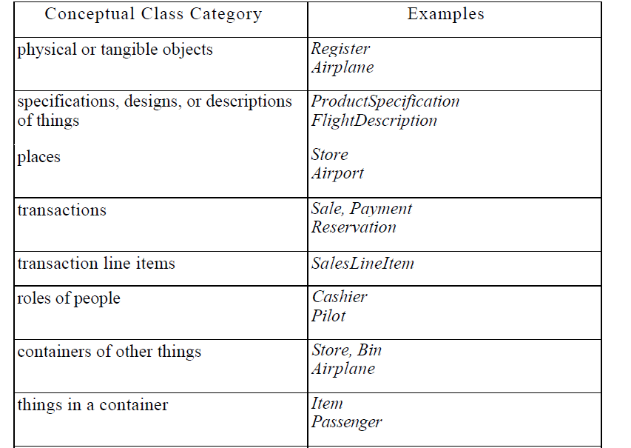

Slide 15
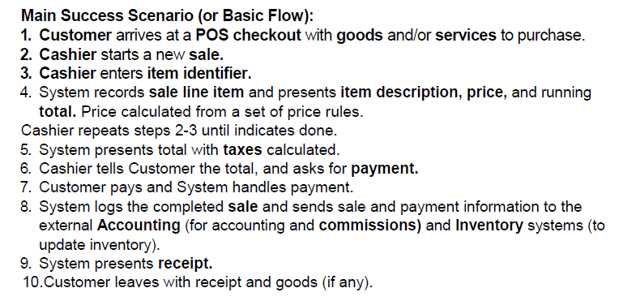
Finding Conceptual Classes with Noun Phrase Identification

Slide 16
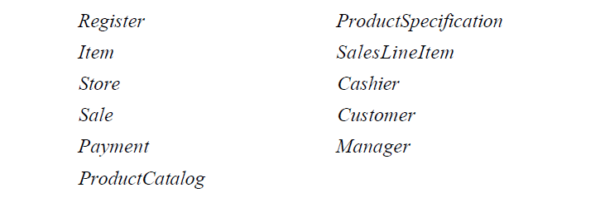
Candidate Conceptual Classes for the Sales Domain

Slide 17
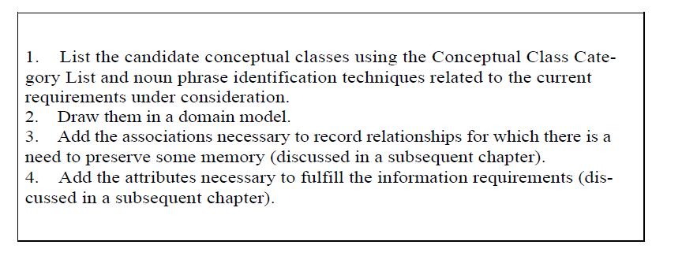
How to Make a Domain Model

Slide 18
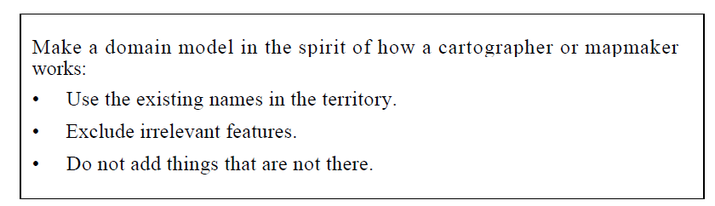
On Naming and Modeling Things

Slide 19
A Common Mistake in Identifying Conceptual Classes
If we do not think of some conceptual class X as a number or text in the real world, X is probably a conceptual class, not an attribute.

Slide 20
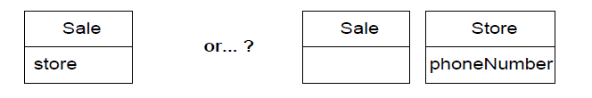
Example

Slide 21
Modeling the Unreal World
Some software systems are for domains that find very little analogy in natural or business domains; software for telecommunications is an example.
For example, here are some candidate conceptual classes related to a telecommunication
switch: Message, Connection, Port, Dialog, Route, Protocol.

Slide 22
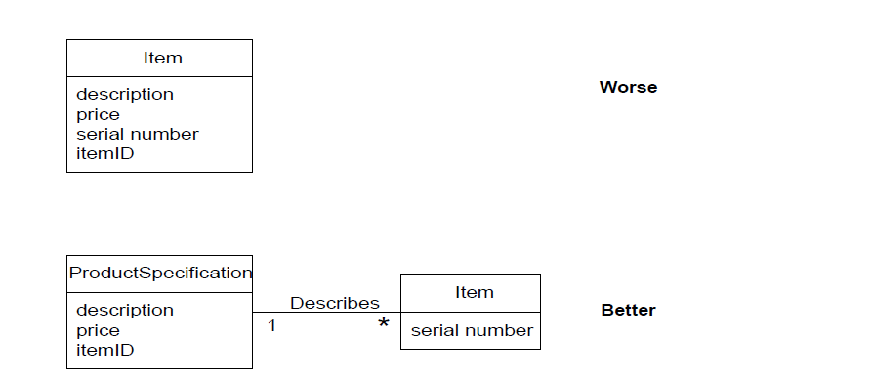
The Need for Specification or Description Conceptual Classes

Slide 23
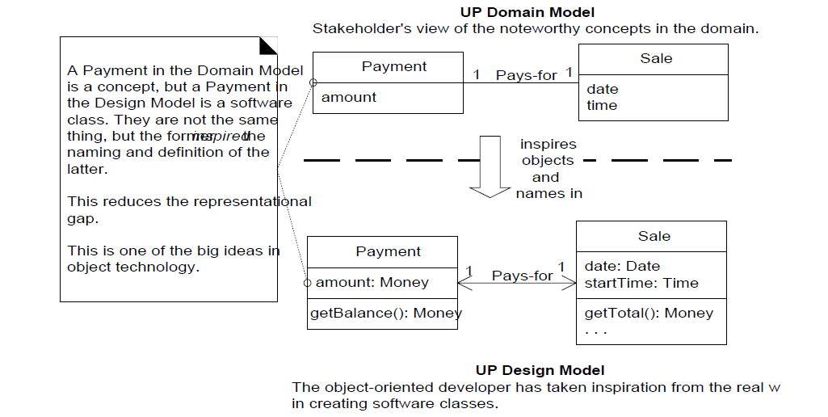

Slide 24
References
Chapter 10 Applying UML Patterns (Applying UML Patterns: An Introduction To Object-Oriented Analysis And Design) Craig L

